Slide 1

Why HAVE the Chinese become more tolerate on puppy love SINCE late 2000s: A Functional ANALYSIS
Yilun Dai

Slide 2
Research Question: Introduction
The Chinese Definition of puppy love: 早恋 (zao lian, early love), most commonly refer to dating and having a love relationship before college
Puppy love has been a taboo from 1950s to early 2000s
However, there has been an increasing tolerance on puppy love since late 2000s
Why are Chinese people changing their opinion?

Slide 3
Research Question: past literature
Shen, Y. (2015). Too young to date! The origins of zaolian (early love) as a social problem in 20th-century China. History Of Science, 53(1), 86.
Provided structural explanation for this taboo in 20th century
Purpose: to prevent early marriage, early birth and school drop-outs
Qualitative analysis on political documents
Wang, J. (2013, August 31). Puppy love no longer taboo [Electronic version]. Shanghai Daily
Gave cultural explanations on the change: many parents themselves experienced puppy love and controlling parents, and therefore are more understanding

Slide 4
Research Question: This Project
Will provide functional and structural explanation on the recent change in attitude towards puppy love
Will use computational methods and quantitative analysis

Slide 5
Data used
Love relationships and marital status statistics from China Family Panel Studies (PKU and i.baihe.com, 2015)
Movie and TV series data from Douban
Chinese Fertility rate and marriage rate statistics from the World Bank
Study abroad statistics: National Bureau of Statistics of China

Slide 6
Data used: Fertility Rate
Plunging fertility rate since 1990
One Child Policy became effective in 1980s not 90s
little change even after the “second child policy”

Slide 7
Data used: Number of Students studying abroad
Form of education is diversifying
College Entrance Exam (Gaokao) is no longer the only way to higher education
Score is no longer the one and only standard for “good student”

Slide 8
Methods and tools
Web crawling: fetching TV series data from Douban
Tool: Beautifulsoup in Python
Digital Survey on first love age, opinions on marriage, and childbirth
Time Series Analysis: constructing VAR models with exogenous variables and conduct Granger Causality test
Tool: R studio

Slide 9
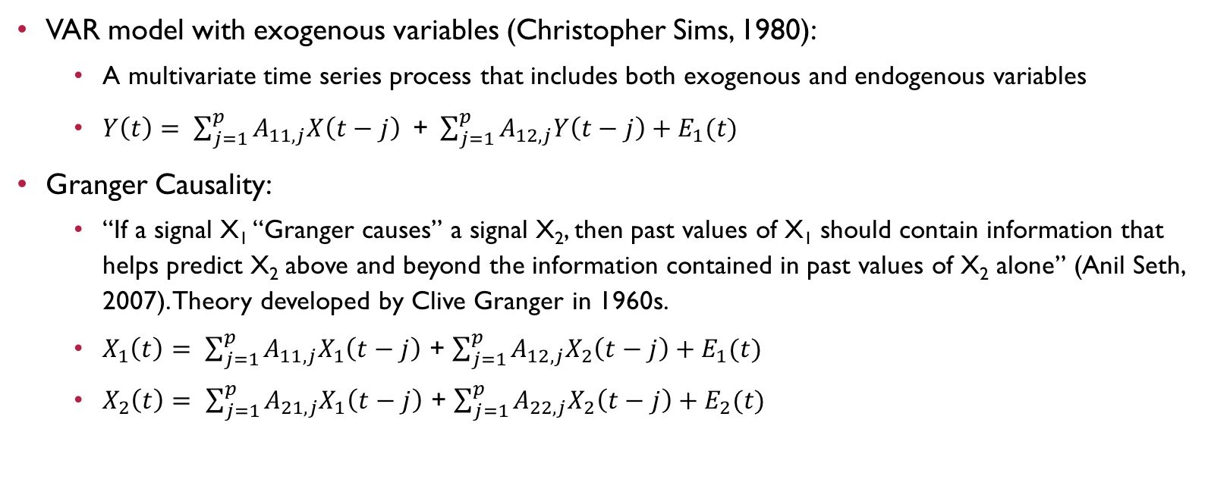
Theories used:
VAR model with exogenous variables (Christopher Sims, 1980):
A multivariate time series process that includes both exogenous and endogenous variables
$Y\left(t\right)= \sum_{j=1}^{p}{A_{11, j}X\left(t−j\right)}\text{ + }\sum_{j=1}^{p}{A_{12, j}Y\left(t−j\right)}+E_{1}(t)$
Granger Causality:
“If a signal X₁ “Granger causes” a signal X₂, then past values of X₁ should contain information that helps predict X₂ above and beyond the information contained in past values of X₂ alone” (Anil Seth, 2007). Theory developed by Clive Granger in 1960s.
$X_{1}\left(t\right)= \sum_{j=1}^{p}{A_{11, j}X_{1}\left(t−j\right)}$ + $\sum_{j=1}^{p}{A_{12, j}X_{2}\left(t−j\right)}+E_{1}(t)$
$X_{2}\left(t\right)= \sum_{j=1}^{p}{A_{21, j}X_{1}\left(t−j\right)}$ + $\sum_{j=1}^{p}{A_{22, j}X_{2}\left(t−j\right)}+E_{2}(t)$

Slide 10
Hypothetical result
The number of TV series that have puppy love contents is increasing
The declining fertility rate and marriage rate, and the increasing number of students studying abroad granger cause the increasing tolerance of puppy love in China

